Slide 1

FOR STUDENTS
Meet Mr. Cadabra
The math tutor who talks you through it — one friendly step at a time.
MyTutor · with Mr. Cadabra · mrcadabra.com
Notes:
Hi! This is MyTutor, and that's Mr. Cadabra. He's a math tutor who actually talks — and he's about to become your favorite way to do math.

Slide 2
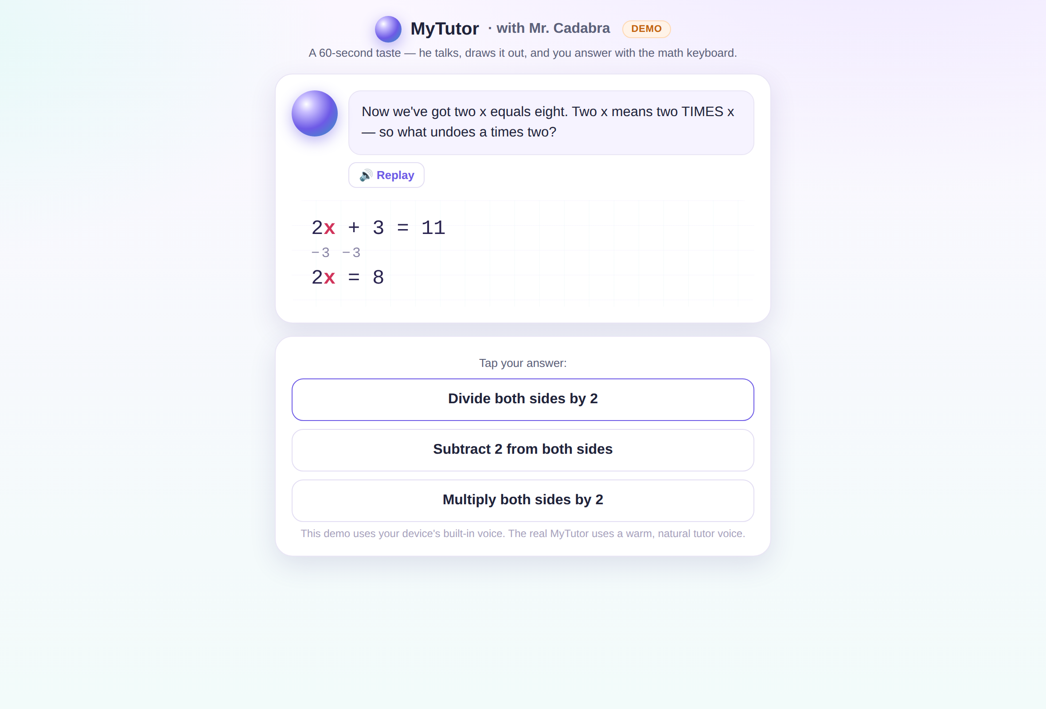
He talks. The board draws. You type.
Turn your sound on — he explains every step out loud while the whiteboard draws it. When it's your turn, type your answer and press Enter. The board never jumps ahead of you.
Notes:
Here's how a lesson works. Mr. Cadabra explains each step out loud while the whiteboard draws it, and when it's your turn, you just type your answer. The board never runs ahead of you — it waits for YOUR move.

Slide 3
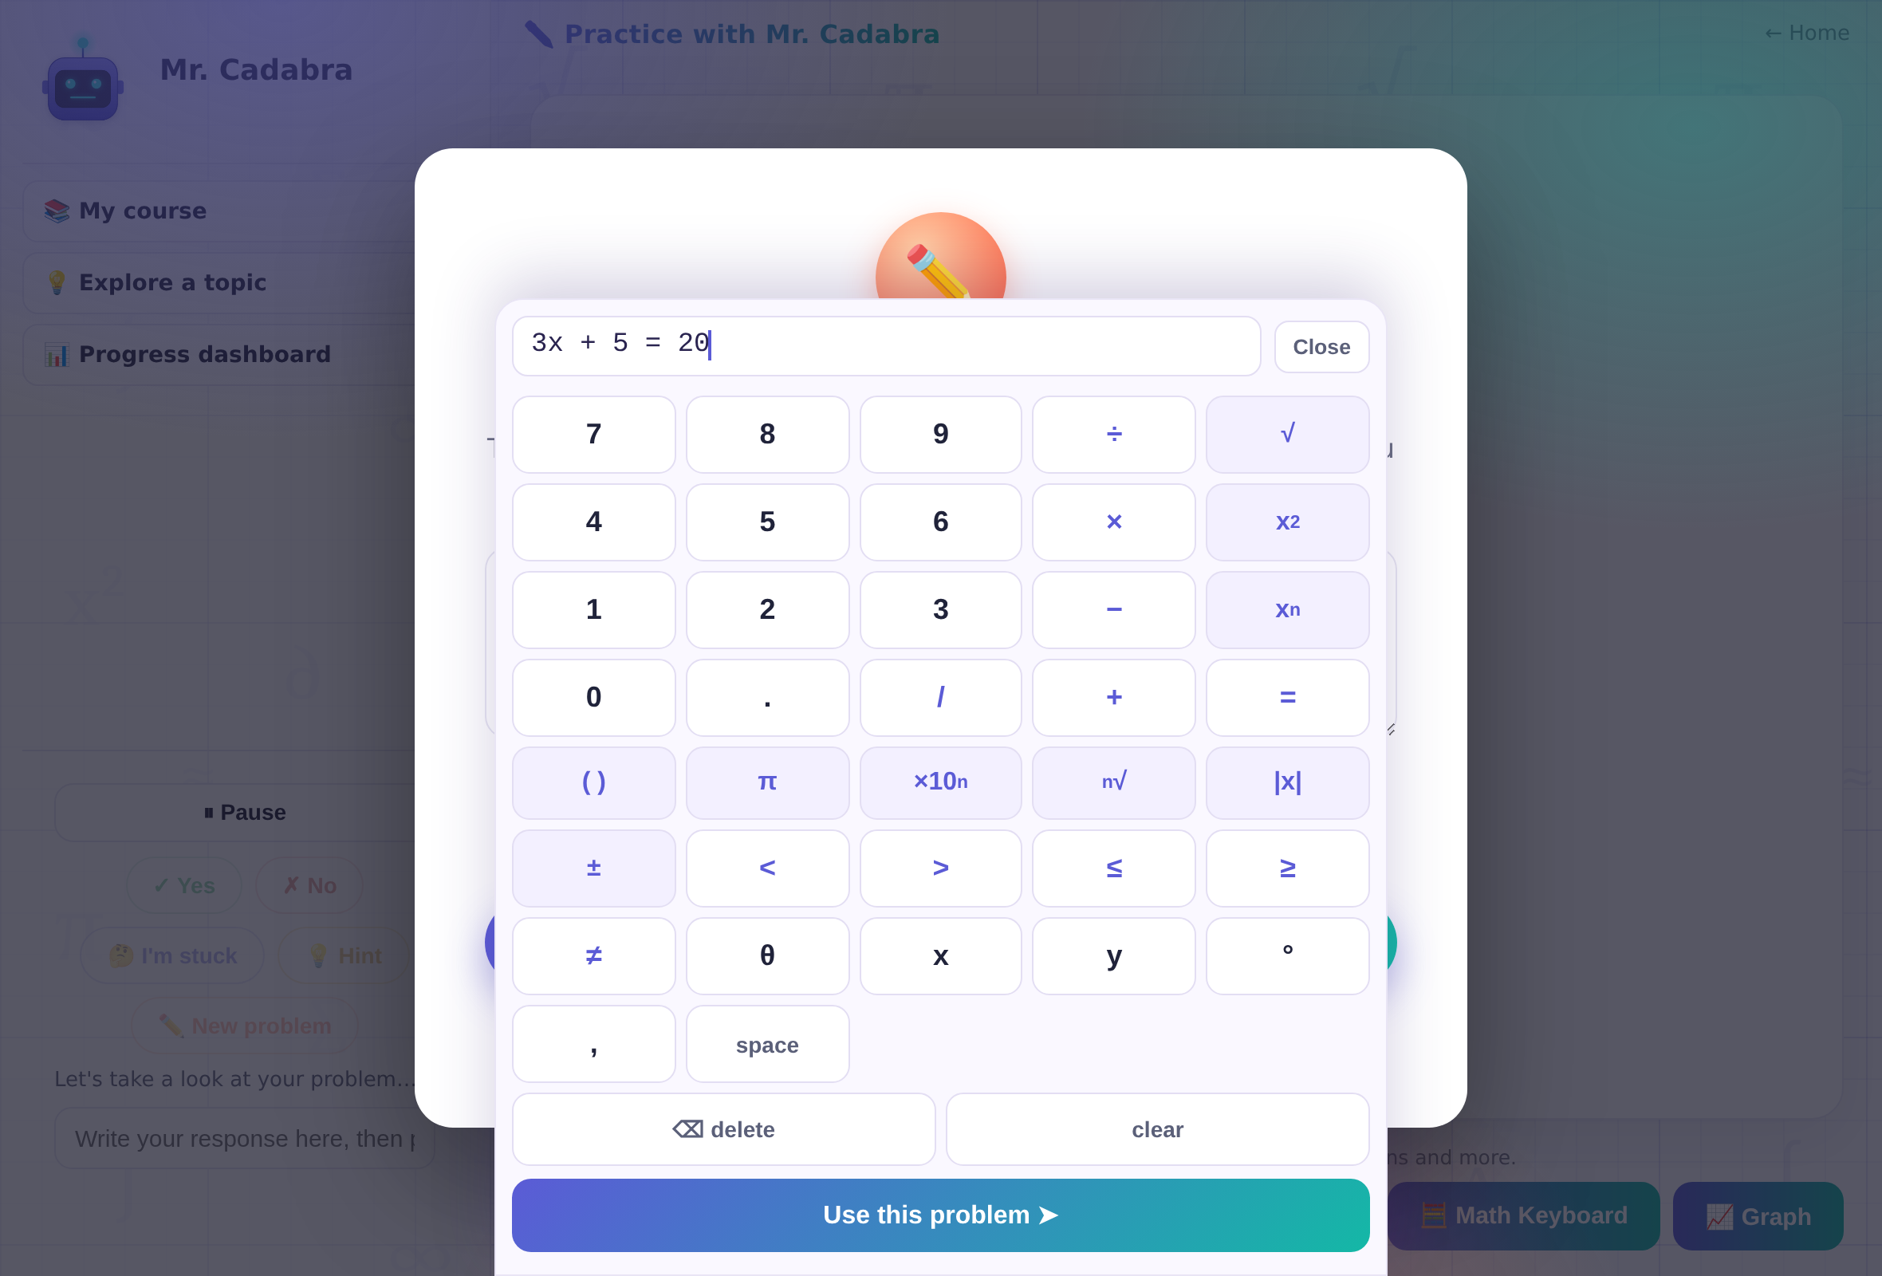
Real math symbols, no hunting.
Tap 🧮 Math Keyboard for √, x², fractions and more. For powers: type the base, tap xⁿ, then the power — 2, xⁿ, 3 makes 2³. Stuck on any button? Just ask him.
Notes:
Need a square root or an exponent? Tap the Math Keyboard and every symbol is right there. And if you're ever unsure how something works, just ask Mr. Cadabra — he knows every button on the screen.

Slide 4
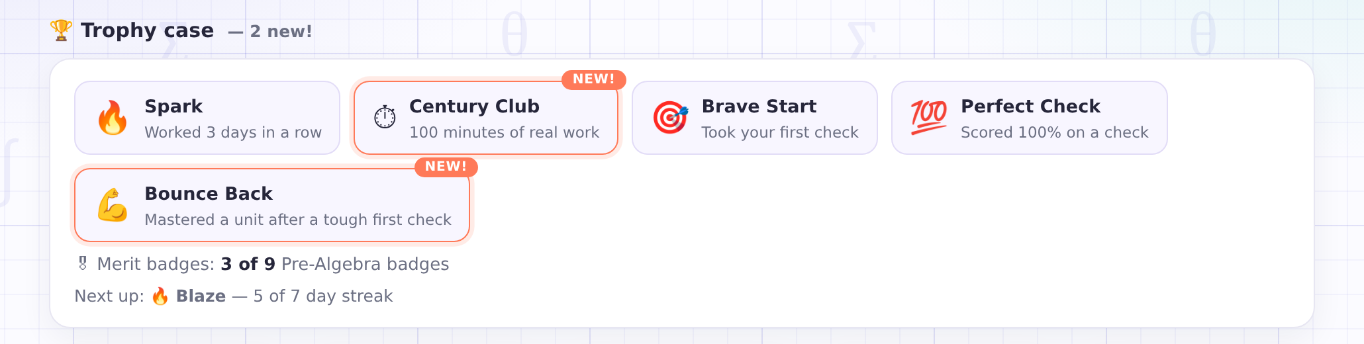
Earn it: badges, medals, and trophies.
Master a unit and its merit badge is yours — nine per course, and a trophy when you finish all nine. Medals reward the work itself: streaks, real minutes, comebacks.
Notes:
And here's the fun part: everything you do earns something. Master a unit and its merit badge goes in your trophy case. Keep a streak alive, put in real minutes, bounce back from a tough check — there's a medal for every one of them. Nothing here is a participation trophy. You earn it all.

Slide 5
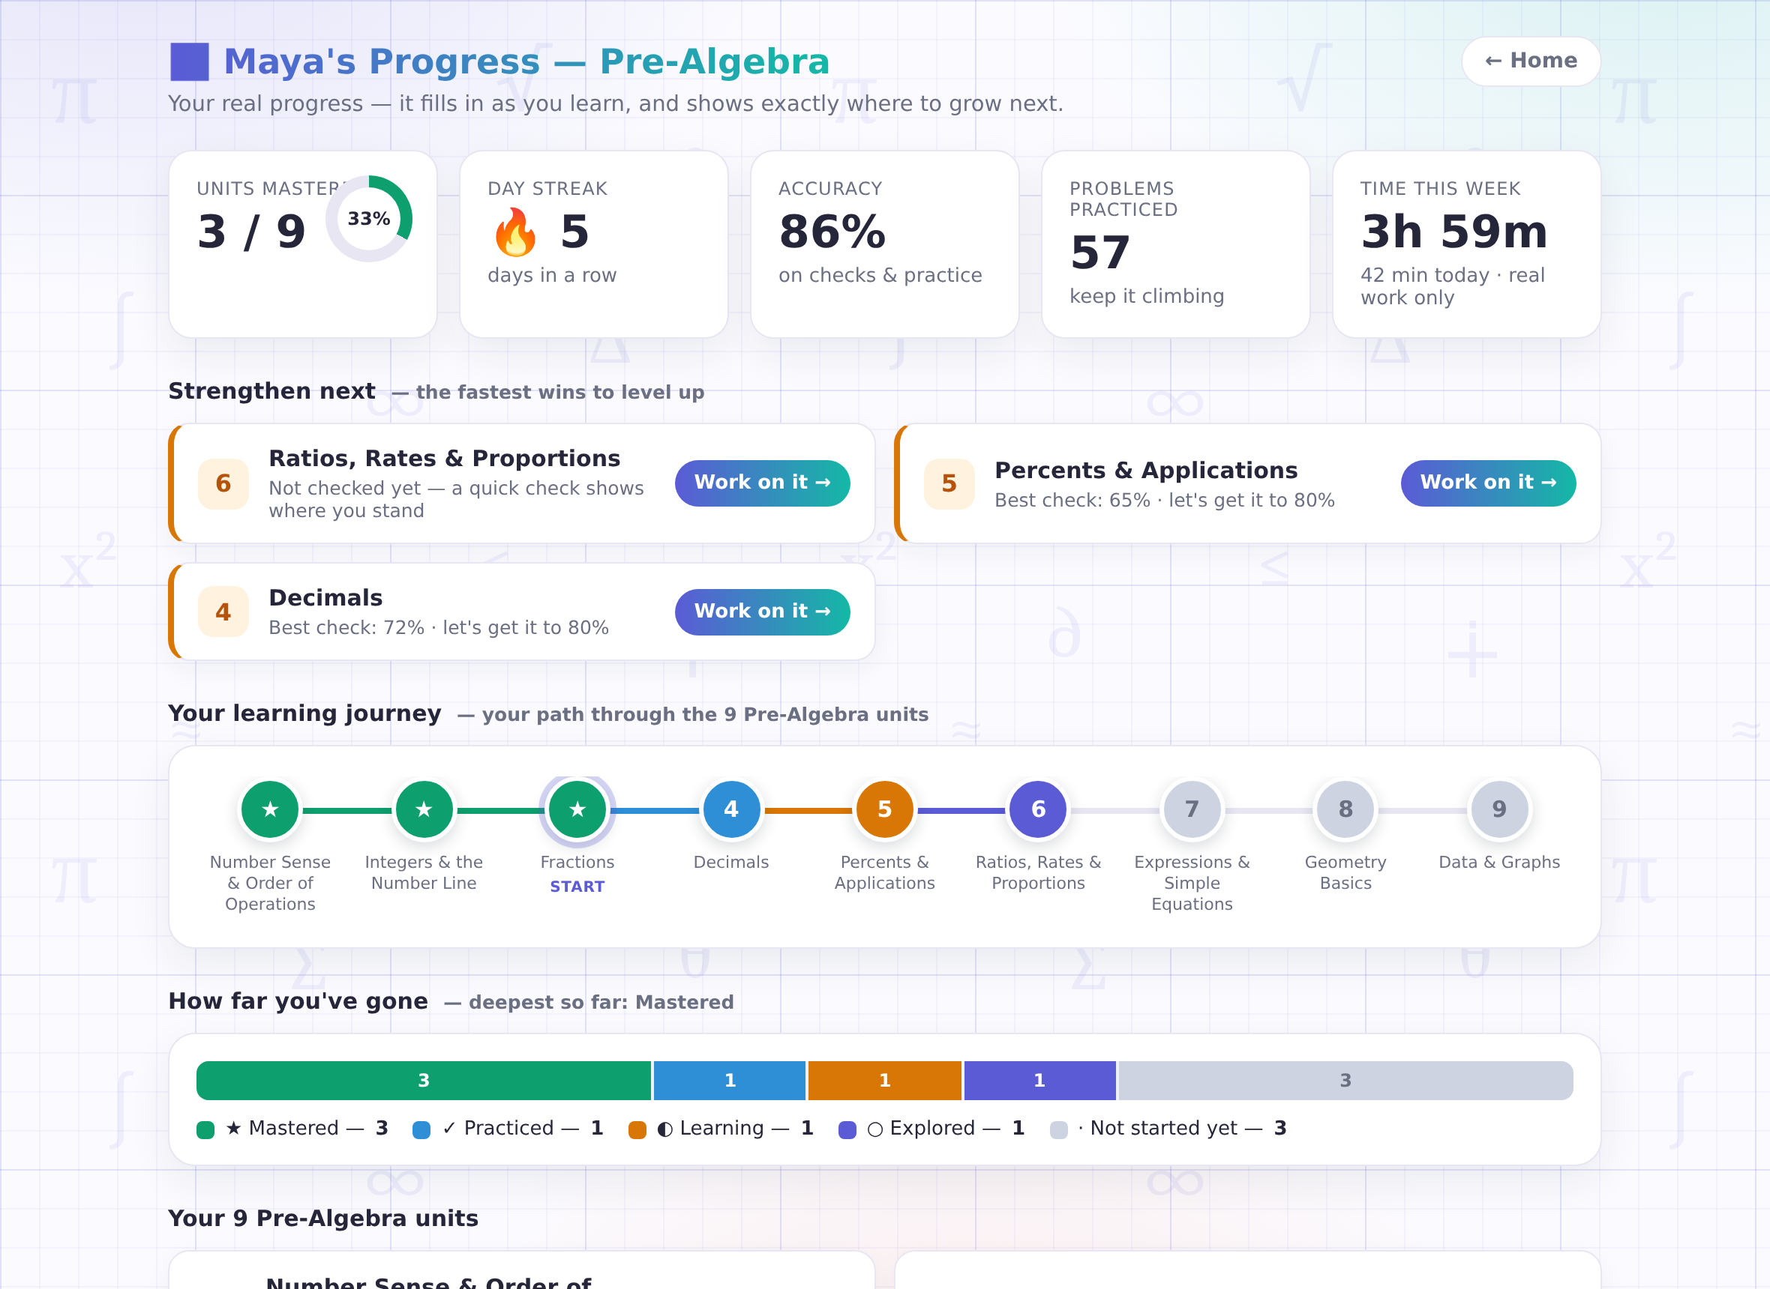
Watch your journey fill in.
Your dashboard shows your whole path — units turn gold with a star when you master them. Keep the 🔥 streak alive and watch your accuracy climb.
Notes:
Your dashboard shows your whole journey through the course. Units turn gold as you master them, your streak grows every day you show up, and there's always a 'next up' so you know exactly what to chase.

Slide 6
Ready to earn your first badge?
Try a lesson right now — no sign-up needed.
mrcadabra.com/demo
Notes:
So — ready to earn your first badge? Try a lesson right now at mrcadabra.com. Mr. Cadabra is waiting, and he's got all the patience in the world.

